Slide 1

Exploratory Data Analysis
Oluwaseun Ilori

Slide 2
Introduction
Sequoia Capital is a leading American venture capital firm known for investing in high-growth technology companies.
Founded in 1972
Funded - Apple, Airbnb, Dropbox, Yahoo!, Google, Oracle, Instagram, and LinkedIn.

Slide 3
Objective
Identify Popular Investment Categories
Analyze popular partners and their investment categories

Slide 4
Data Overview
Data source: https://www.sequoiacap.com/our-companies/#all-panel
19 Columns
Company's name
Short description, Full description
Current stage – Pre-seed/seed, Early, Growth, IPO, Acquired
Partners
Founded year, Partnered year , Acquired year, IPO year
Team members, social media links, career links
341 Companies
30 Partners
7 Categories - AI/ML, Climate Tech, Consumer, Crypto, Enterprise, FinTech, Healthcare

Slide 5
Data Overview - Contd
Category | Focus | Key Areas | Applications
AI/ML | Intelligent automation | NLP, computer vision, predictive analytics | Healthcare, finance, retail
Climate Tech | Environmental sustainability | Renewable energy, energy storage, carbon capture | Energy, transportation, waste management
Consumer | Direct-to-consumer products | E-commerce, consumer electronics, food & beverage | Retail, entertainment, lifestyle
Crypto | Digital currencies and blockchain | Cryptocurrencies, blockchain, DeFi | Finance, smart contracts, supply chain
Enterprise | Business solutions | Enterprise software, cloud computing, cybersecurity | Business operations, data management, IT services
FinTech | Financial technology | Digital payments, lending, wealth management | Banking, insurance, investments
Healthcare | Medical and health innovations | Medical devices, digital health, biotech | Diagnostics, treatment, healthcare management

Slide 6
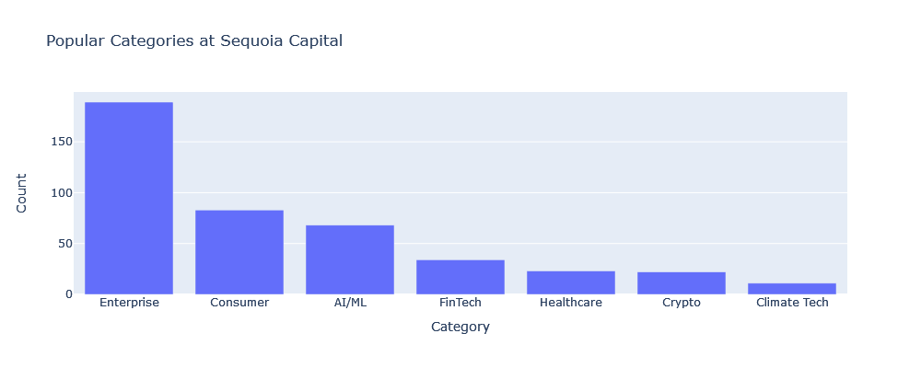
Popular categories

Slide 7
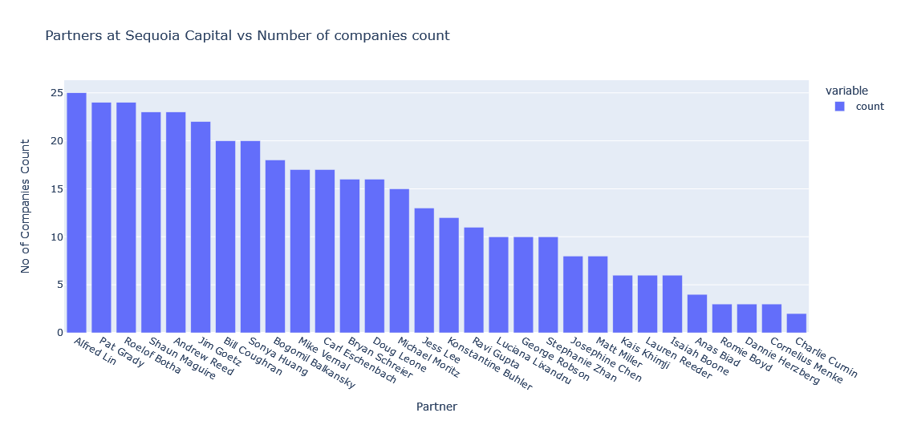
Most Popular partners

Slide 8
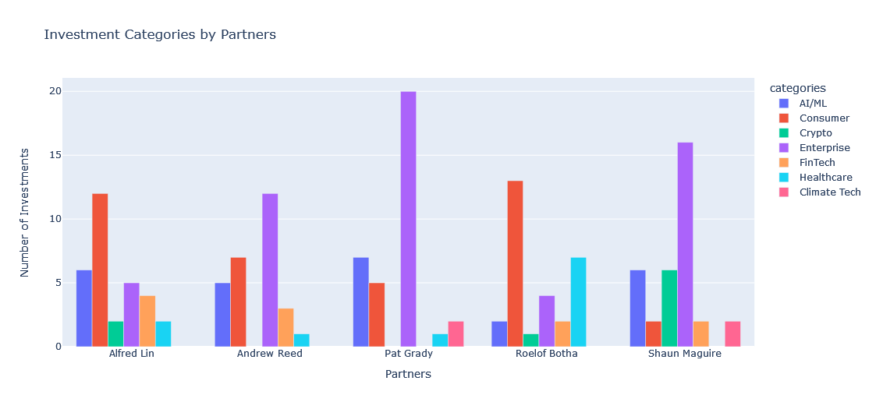
Company Categories where top 5 partners are involved in

Slide 9
Key Insights and findings
Top 3 Investment Categories: Sequoia Capital focuses its investments on Enterprise, Consumer, and AI/ML technologies.
Top 5 Partners: Key partners for investments are Alfred Lin, Andrew Reed, Pat Grady, Roelof Botha, and Shaun Maguire.
Strategic Focus for Cold Emailing: To optimize outreach efforts, prioritize categories such as AI/ML and partners including Alfred Lin, Andrew Reed, Pat Grady, Roelof Botha, and Shaun Maguire.
Investment Preferences Among Partners: Alfred Lin, Andrew Reed, Pat Grady, and Shaun Maguire exhibit a stronger inclination towards investing in AI/ML companies compared to Roelof Botha.
Roelof Botha's Focus: Roelof Botha demonstrates a preference towards consumer technologies.

Slide 10
Conclusion
Scraped and analyzed data from Sequoia Capital's Companies Page.
Containing 341 companies across 7 categories.
Key Insights:
Top Categories: Enterprise, Consumer, AI/ML.
Key Partners: Alfred Lin, Andrew Reed, Pat Grady, Roelof Botha and Shaun Magu

